Slide 1

IMAGE CAPTION GENERATION USING CNN
IV-II CSE-B
Batch No : 9
1. Sayed Beebi 18ME1A05A0
2. Nalluri Jahnavi 18ME1A0575
3. Rayavarapu Anil Kumar 18ME1A0594
4. Shaik Isaac Roshan 18ME1A05A5
Guide
Mr. Y. Nagendra Kumar
Assistant Professor
Dept. Of CSE

Slide 2

ABSTRACT
In the modern era, image captioning has become one of the most widely required tools. Moreover, there are inbuilt applications that generate and provide a caption for a certain image, all these things are done with the help of deep neural network models. The process of generating a description of an image is called image captioning. It requires recognizing the important objects, their attributes, and the relationships among the objects in an image.

Slide 3
ABSTRACT
(CONTINUED)
It generates syntactically and semantically correct sentences. In this project, we present a deep learning model to describe images and generate captions using computer vision and machine translation. This project aim is to detect different objects found in an image, recognize the relationships between those objects and generate captions. The programming language used in this project is Python.

Slide 4
EXISTING SYSTEM
In previous model it is based on a deep learning neural network that consists of a vision CNN. It generates complete sentences as an output captions or descriptive sentences. By using VGG16 model it can automatically describe the content of a picture using properly formed English sentences. This model was advantageous in naming the objects in an image but it could not tell us the relationship among them(that’s plain image classification) when the image is not clear .

Slide 5
PROPOSED SYSTEM
In this we are differentiating the image given as input whether it is valid or not . In the existing one it was accepting the invalid input and generating the false captions. So we add on a module to differentiate the blur image and clear image. The caption will be generated if the image is valid or else it generates a alert message. We can also generate the caption for images which are not present in the dataset.

Slide 6
BLOCK DIAGRAM

Slide 7
TECHNOLOGIES
Deep Learning
CNN
LSTM
Python
OpenCV
Matplotlib
Keras
Pandas
VGG16
TensorFlow

Slide 8
REQUIREMENTS
Software Requirements
Operating system: Windows
Jupyter
Python 3.8
Hardware requirements:
Processor: ×86, 64-bit CPU
Storage: 8GB Free Disk Space
4 GB RAM

Slide 9
UML DIAGRAMS
A UML diagram is a diagram based on the UML (Unified Modeling Language) with the purpose of visually representing a system along with its main actors, roles, actions, artifacts or classes, in order to better understand, alter, maintain, or document information about the system.
It is based on diagrammatic representations of software components. By using visual representations, we are able to better understand possible flaws or errors in software or business processes.

Slide 10
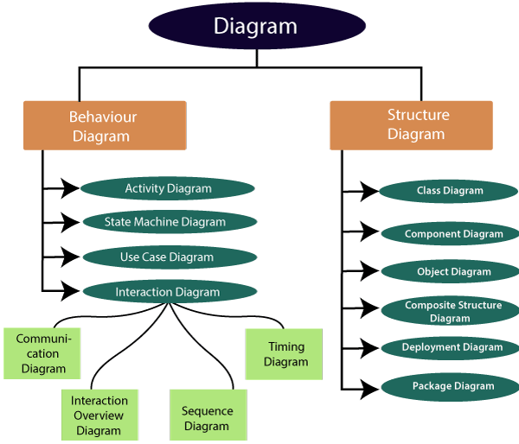
TYPES OF UML DIAGRAMS The UML diagrams are categorized into structural diagrams, behavioral diagrams.

Slide 11
STRUCTURAL DIAGRAMS
Structural diagrams depict a static view or structure of a system. It is widely used in the documentation of software architecture. It embraces class diagrams, composite structure diagrams, component diagrams, deployment diagrams, object diagrams, and package diagrams. It presents an outline for the system. It stresses the elements to be present that are to be modeled.

Slide 12
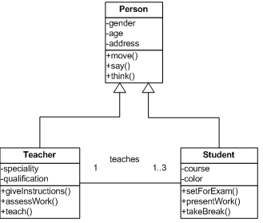
Class Diagram:
Class diagrams are one of the most widely used diagrams. It is the backbone of all the object-oriented software systems. It depicts the static structure of the system. It displays the system's class, attributes, and methods. It is helpful in recognizing the relation between different objects as well as classes.

Slide 13
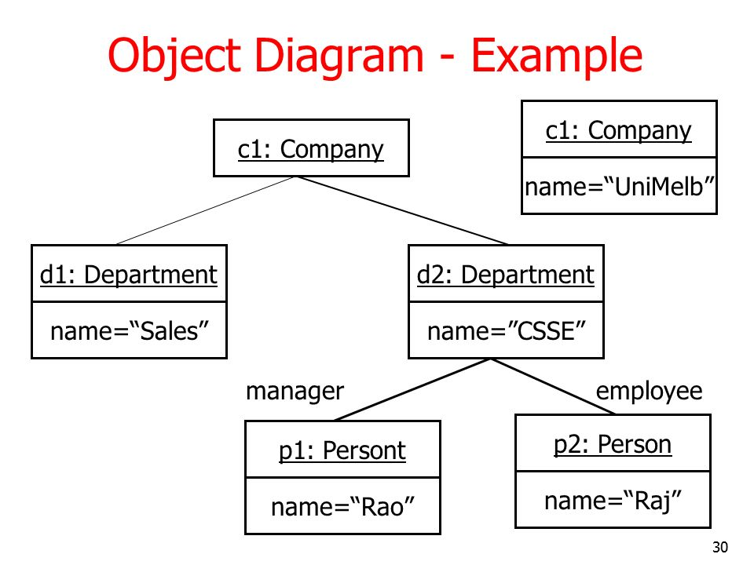
Object Diagram:
It describes the static structure of a system at a particular point in time. It can be used to test the accuracy of class diagrams. It represents distinct instances of classes and the relationship between them at a time.

Slide 14
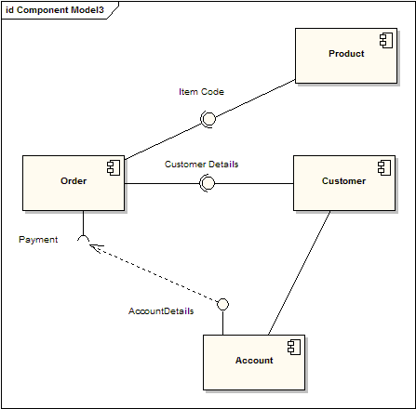
Component Diagram:
It portrays the organization of the physical components within the system. It is used for modeling execution details. It determines whether the desired functional requirements have been considered by the planned development or not, as it depicts the structural relationships between the elements of a software system.

Slide 15
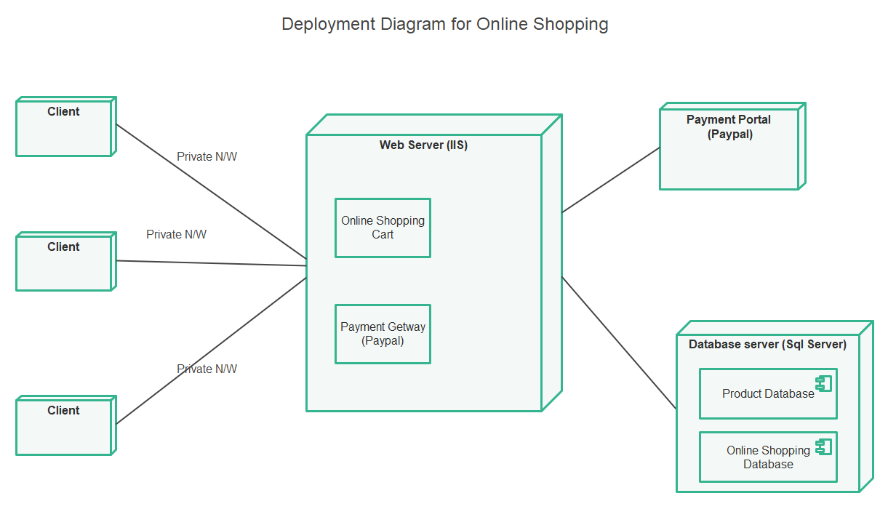
Deployment Diagram:
It presents the system's software and its hardware by telling what the existing physical components are and what software components are running on them. It produces information about system software. It is incorporated whenever software is used, distributed, or deployed across multiple machines with dissimilar configurations.

Slide 16
BEHAVIORAL DIAGRAMS
Behavioral diagrams portray a dynamic view of a system or the behavior of a system, which describes the functioning of the system. It includes use case diagrams, state diagrams, and activity diagrams. It defines the interaction within the system.

Slide 17
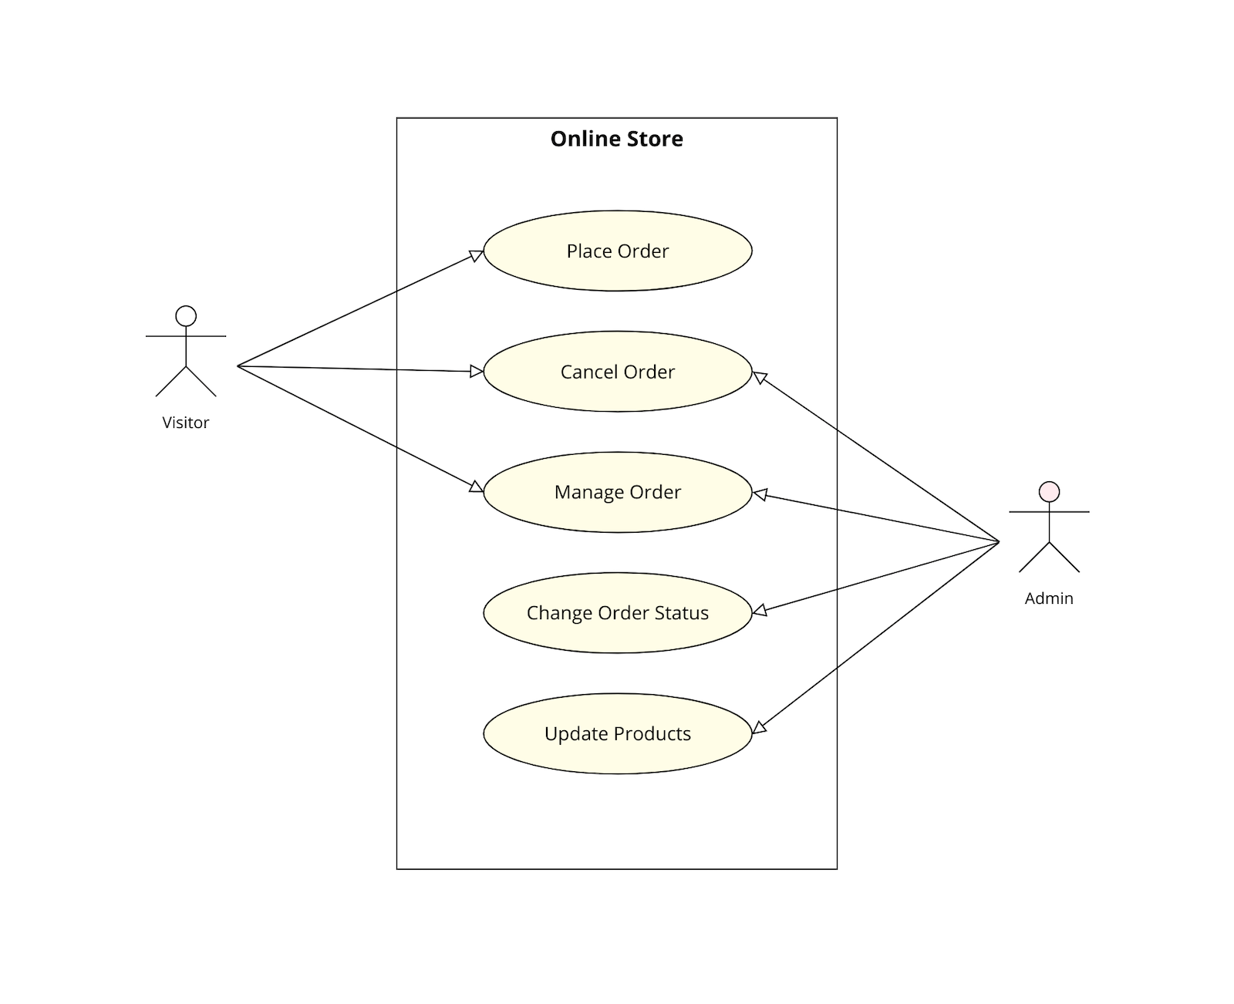
Use Case Diagram:
It represents the functionality of a system by utilizing actors and use cases. It encapsulates the functional requirement of a system and its association with actors. It portrays the use case view of a system.

Slide 18
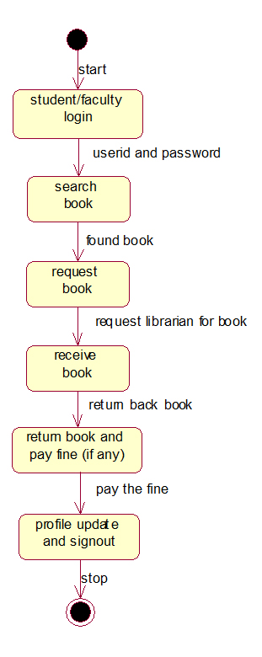
State Machine Diagram:
It is a behavioral diagram. It portrays the system's behavior utilizing finite state transitions. It is also known as the State-charts diagram. It models the dynamic behavior of a class in response to external stimuli.

Slide 19
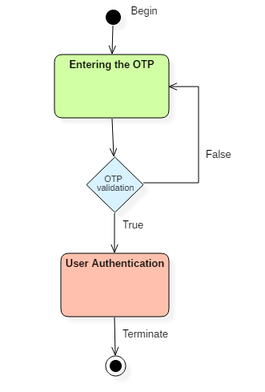
Activity Diagram:
It models the flow of control from one activity to the other. With the help of an activity diagram, we can model sequential and concurrent activities. It visually depicts the workflow as well as what causes an event to occur.

Slide 20
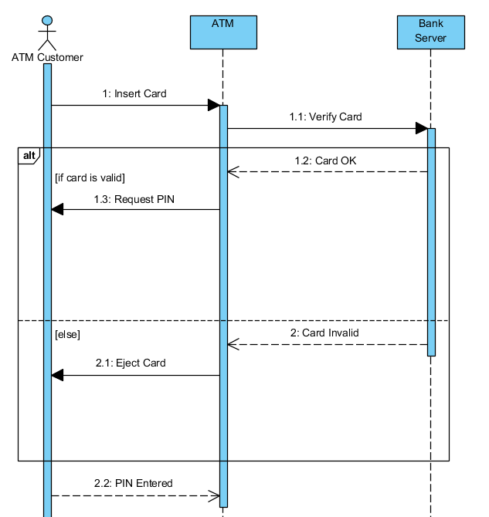
Sequence Diagram:
It shows the interactions between the objects in terms of messages exchanged over time. It delineates in what order and how the object functions are in a system.

Slide 21
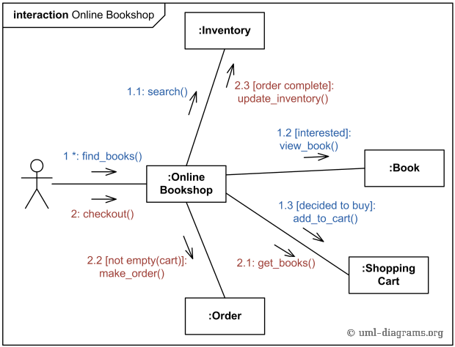
Collaboration Diagram:
A collaboration diagram, also known as a communication diagram, is an illustration of the relationships and interactions among software objects in the Unified Modeling Language (UML).

Slide 22
CLASS DIAGRAM

Slide 23
SEQUENCE DIAGRAM

Slide 24
USECASE DIAGRAM

Slide 25
ACTIVITY DIAGRAM

Slide 26
STATE CHART DIAGRAM

Slide 27
THANKS!

